Slide 1


Alpha Phi Omega
Chi Chapter at UCLA
Alpha Lambda / Yuna Choi Term, Meeting 2
March 12, 2014
www.apo-x.org

Slide 2
Agenda
1. Officer Updates and Announcements
2. Chapter Business
3. Last Announcements

Slide 3
President
Jessica Suhardjo
president@apo-x.org
Executive Committee
excomm@apo-x.org

Slide 4

Leadership Workshops
All currently available online workshops are up
Sign up!
Want to host a leadership workshop?
Let me know!

Slide 5

New Meeting Room!
Spring Quarter Meeting Room
Perloff 1102
Extra weekly room
Fridays 7-9pm
Ackerman 3517

Slide 6
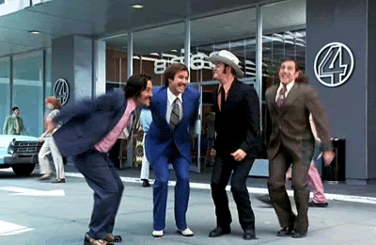
Gamer’s Guide Tip # 2
When the best leader’s
work is done,
the people will say,
“We did it ourselves”
- Lao Tzu

Slide 7
Sergeant-at-Arms
Catherine Teotico
apoxsergeant@gmail.com

Slide 8
And the ABEA goes to….

Slide 9
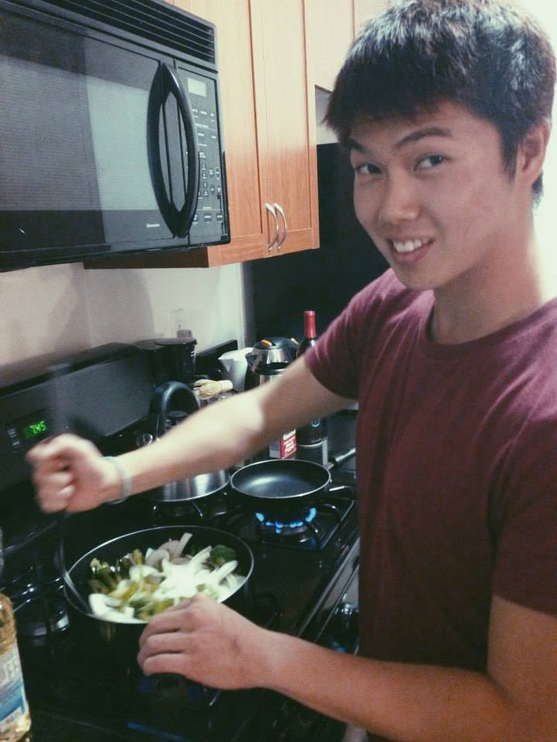
ANDREW SUH!!
Wow so LACMA was really fun and interesting. First of all, we got free parking. Second, OMFG we got a buffet of mashed potato in a martini. You know where we were the first 10 minutes of the event. + our group picture in the photo booth is just too cute. So we took pictures, had fun, ate mashed potato, and toured two exhibits. We first went to an iconic and avant-garde. So we replaced the lyrics to "I Don't Care" by Icona Pop. It goes like... Avant-Garde~ Iconic!~ lolol. So we were trying to blow on the mobile arts made because I mean... it's a mobile... we made them move and realized Emily is amazing at blowing ;). I tried to take a picture of the "No photography" but I couldn't. :(. We went to the next exhibit...but I forgot the name. It was the one with the hands. So much trip. We had a lot of fun. We later ended up looking at this amazing huge hot wheels looking thing that had like 500 hot wheels and a huge track that had a lot of turns and inclines and declines. We went upstairs to take a picture and I started recording and the security said no videos and told me to leave. I was so sad, but he said he was just kidding I didn't need to leave, but no videos. He later started to talk to me about life and how I should finish college instead of ending up like him working like 10 hours and he started talking to me about how he wanted to see something like the Maury show where a kid would rebel against his mom. I was thinking in my head, "omg we gotta go.. omg we gotta go" but I was stuck. Stuck in this conversation about how I have to make it in life. He told me he "had" friends. Had. past tense. He said finish college and don't end up doing something like him. Honestly, it was nice that someone was encouraging me...I guess? but it was like damn i gotta get on my game. LACMA was really fun and we ended up talking about fun things and I got to hangout with people I usually don't get to hangout with. Everyone got to enter even if they didn't reserve their ticket because there was a standby line. Definitely rcommended going back if they have more college nights! We loved the mashed potatoes. We wanted to take some back... I REALLY HAD FUN. It was great to hangout with emily because she's my pbro and we don't really hangout. So much fun emily~<3. And of course shoutout to electric skyline~.

Slide 10
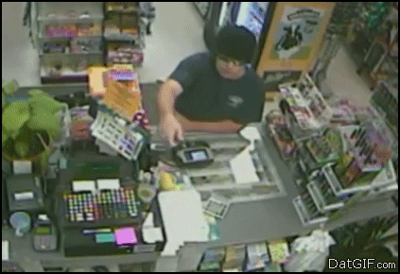
Now on to... CHAIRING

Slide 11

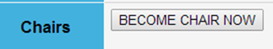
Step 1: Sign up to become the chair for an event on the Chapter Website
What does that mean?
Click the button this button ->
You need to sign up at least 3 days in advance!
WHY? You need enough time to complete everything in the chairing guidelines
FAQ
What if its 2 or less days before the event? DO NOT CLICK THE BUTTON!!
WHY? You cannot complete the entire chairing guidelines in time and that would result in improper chairing. (No chair credit but no strike)
However, YOU/ another participant will still need to organize the event despite not receiving chairing credit.
ALL EVENTS WILL HAPPEN REGARDLESS OF A CHAIR
It is YOUR responsibility and not Excomm to organize the event
Notes:
Talk about the alternative: You sign up late and get a strike. We thought that this would be more fair.
Events will happen. So If rides need to be arrange, someone needs to make that happen still despite not officially being chair. NOT EXCOMM!!
Remember that you are representing ALPHA PHI OMEGA in all of the activities you participate in so be mindful of your actions.

Slide 12
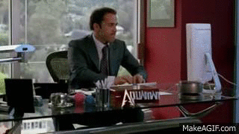
Step 2: Email all listed attendees, SAA & the respective VPs 3 days before the event
What does that mean?
Email with all the relevant information:
Subject Line: Official Title, Date, Time (Ex. [FUND] Spam Musubi Sale 3/9 12am)
Location, Time, Pins/ Letters****, Special Instructions
Driver’s List When Necessary
You need to do this 3 days before the event!
WHY? It gives people time to remove themselves of the list if needed.
FAQ
What if its 2 or less days before the event? You don’t need to send it to SAA & VPS
WHY? You missed the deadline for why the email was necessary.
However, YOU/ another participant will still need to send attendees emails if drivers are involved.
ALL EVENTS WILL HAPPEN REGARDLESS OF A CHAIR
AGAIN, It is YOUR responsibility and not Excomm to organize the event
Regardless of when you click the chair button, if the email comes late you get a strike. So again, for your sake. Don’t click the button, if you are signing up late
Notes:
Note Pins, if Service. Do not write letters is they cannot where letters.
Also the subject line should be the official name of the event as listed on the website example [ FUND] Spam Musubi. Followed by that date of the event and the shift time

Slide 13
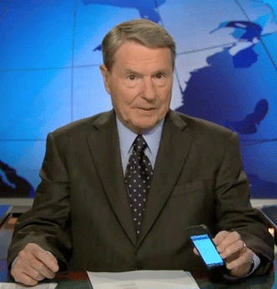
Step 3: Call all listed attendees,
1 day prior to the event
What does that mean?
Call with a relevant information BEFORE 10PM
Location, Time, Pins/ Letters****, Special Instructions
If an attendee cannot be reached, leave a voicemail
You need to do this 1 days before the event!
WHY? Sometimes people forget and just need a reminder so they don’t flake
FAQ
What if its 2 or 1 days before the event? Try to call
WHY? To help brothers out. Even if you don’t get chair credit, Its a nice reminder
Notes:
*** You must call at a decent hour meaning before 10pm. No one should be calling you at 12 midnight for an 8 am service the next day.

Slide 14

Step 4: Arrange Rides
What does that mean?
Provide drivers with directions, maps, and special instructions for parking, etc.
This information should be attached to the reminder email sent to all attendees
You need to do this before the event!
WHY? People need to get to places and not everyone has a car/ likes having to deal with public transportation
FAQ
What if its 2 or 1 days before the event? Still organize this!
WHY? ALL EVENTS WILL HAPPEN REGARDLESS OF A CHAIR
If you don’t show up to an event because you had no one to take you there that is a flake and that results in a strike
Participants need to coordinate with each other on who can drive/ Contact the active or pledge body if they need a driver.
Excomm is not responsible for organizing rides to events.
Remember Finance will only reimbursed if certain criterias are met. Also, save the earth and carpool
Notes:
*** Arrange rides, call every on the list if no one as listed as able to drive to an event. Ask a around if anyone is free to drive through talking to them, texting, calling, or emailing the active or the pledge list. If all else fails, find bus routes for you to take
*** Remember you are not alone, for an event with more than 15 people then there needs to be 2 chairs.
- Pledges, if you are worried about this feel free to talk to an active
- But please do not call excomm expecting them to do all the work for you
Excomm’s primary job is to put up events. It is your jobs what you make of the event we put up
- We can not be chairs for every single even that doesn’t have a chair.
- That does not allow you learn how to be leaders which is one of our cardinal principles.

Slide 15

Step 5: Go to the Event
What does that mean?
Take Attendance, Check for Pins/ Letters, and Maintain Order within the Attendees
Take Pictures or Video of the Event (To be send to Historian)
Whenever possible, any social media of the event is also encourage
Have fun and Enjoy!!
Have a positive attitude! Don’t just complaining about wanting the event to be over, do something, don't just stand around.
FAQ
Flaking in/ Flake
You must notify the chair, if you are flaking in for someone
Someone flaking in does not automatically replace a flake. You must notify the chair that you are specifically flaking in for someone
The originally listed active will get the strike if the flake does not show up for him/her
Notes:
*** Pictures are not for proof but for historian, so you don't need to send it to me . But If I find out that you weren’t at the event, when you said you were you will be in big trouble!!

Slide 16

Step 6: Clean Up, Thank, and Sing!
What does that mean?
Clean Up, Don’t Leave the Place a Mess Before You Go!
Thank the Coordinators, They put a lot of time into this
Sing Toast Song at All Service, IC and Chapter Events. Optional at other events.
RESPECT THE TOAST SONG!!
Don’t laugh/ butcher our toast song! You wouldn’t do that to the national anthem…. Just saying
FAQ
Do I have to toast alone? YUP!
Do we have to toast all together? Nope, but always try to include everyone
Also, notify the chair before you leave. Don’t just do the toast song alone.
Notes:
*** Pictures are not for proof but for historian, so you don't need to send it to me . But If I find out that you weren’t at the event, when you said you were you will be in big trouble!!
Clean up, thank the event coordinators (if present/relevant), and sing the Toast Song. Note: Toast Song is mandatory for all Chapter, Interchapter, and Service events, but optional at all other events.

Slide 17

Step 7: Evaluate the Event Within 3 Days!
What does that mean?
Fill out the evaluation form completely and accurately!
You must do this within 3 days!
Why? It allows tracking to move quickly and efficiently and keep you responsible for your actions
FAQ
What if its late and I am Chair? Turn it in anyway or else none one gets credit
You will however get a strike for improper chairing
What if there was no chair who turns in the evaluation?
For everyone to get credit, someone must turn in an evaluation. No Eval = No Credit
What is its late and No one is Chair?
All participants will receive no credit. Its considered a flake, there will be a strike for all and everyone will get negative hours/ money (depending on the event) & must make it up!
Multiple evaluations for an event is fine so turn in an eval on time!
Notes:
*** Please dont butcher the toast song. Sing it with respect.
*** You can sing the toast song in groups if there is not enough space. You can sing it alone to if no one else is around but you must notify the chair that you are leaving before you leave.

Slide 18
Any Questions?

Slide 19
Administrative VPs
Joseph Chan & Nicola Yip
admin@apo-x.org

Slide 20
Banner Redesign
The banner competition has been extended 1 week. The current banner is NOT part of the competition, rather it is a placeholder for the one to come
LFS Element, UCLA Element, APO Element
The dimensions have changed: 1000 pixels by 200 pixels (WxH)

Slide 21
ALPHA LAMBDA.
SEND US YOUR PROFILE PICTURES FOR THE WEBSITE. ABOUT 15 OF YOU HAVE SENT IT IN.
APOXADMIN@GMAIL.COM
Notes:
** People ahve already received strikes and no chair credit for not evaluating in 3 days so please don't let your efforts go to waste and evaluate

Slide 22
Website Part 1
We are looking to make the “Become Chair Button” greyed out when the calendar event locks.
We hope you like the new changes to the website.
Chair interest button removed

Slide 23
Website Part 2
We will revoke website access for actives who don’t pay dues & submit their active contract by tonight. If there are any issues, please message us.
Suggestions? Let us know!
Notes:
** People ahve already received strikes and no chair credit for not evaluating in 3 days so please don't let your efforts go to waste and evaluate

Slide 24
Membership VP
Jeremy Gozzip & Melissa Ma
membership@apo-x.org

Slide 25
Active Contracts
DUE TODAY.
Committee assignments soon

Slide 26
Rush Make-Ups
Required: 2 Flyering Hours, 2 Rush Events= 4 Total
Contact MVPs if you need to make up anything!

Slide 27
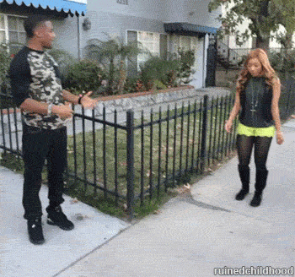
Shout-Out Book
HOLLA! ! !

Slide 28

Spirit Committee Game
Please send two representatives from each family up to play the game.

Slide 29

Active Missions
Coming soon.

Slide 30
Chapter T-Shirt?
Should our chapter have a t-shirt for this term?
(Note: Each person would have to pay for it individually)
What do you all think?

Slide 31
Now for a quick game of...

Slide 32
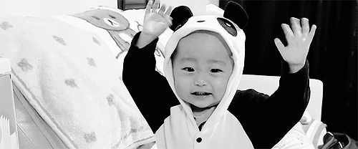
Now for a quick game of...
Guess the Excomm Baby!

Slide 33
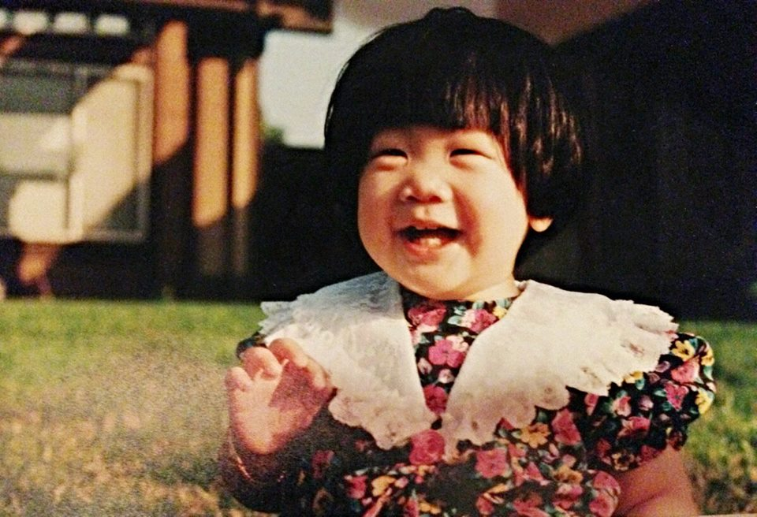
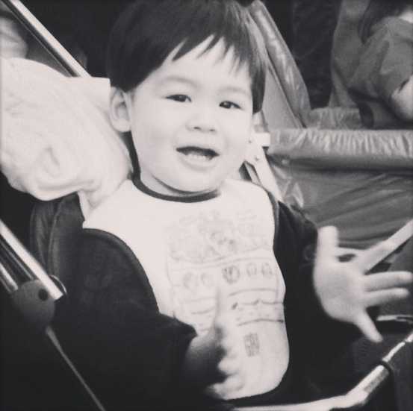
Guess the Excomm Baby!

Slide 34
Guess the Excomm Baby!
Annie Tran
Jeremy Gozzip

Slide 35
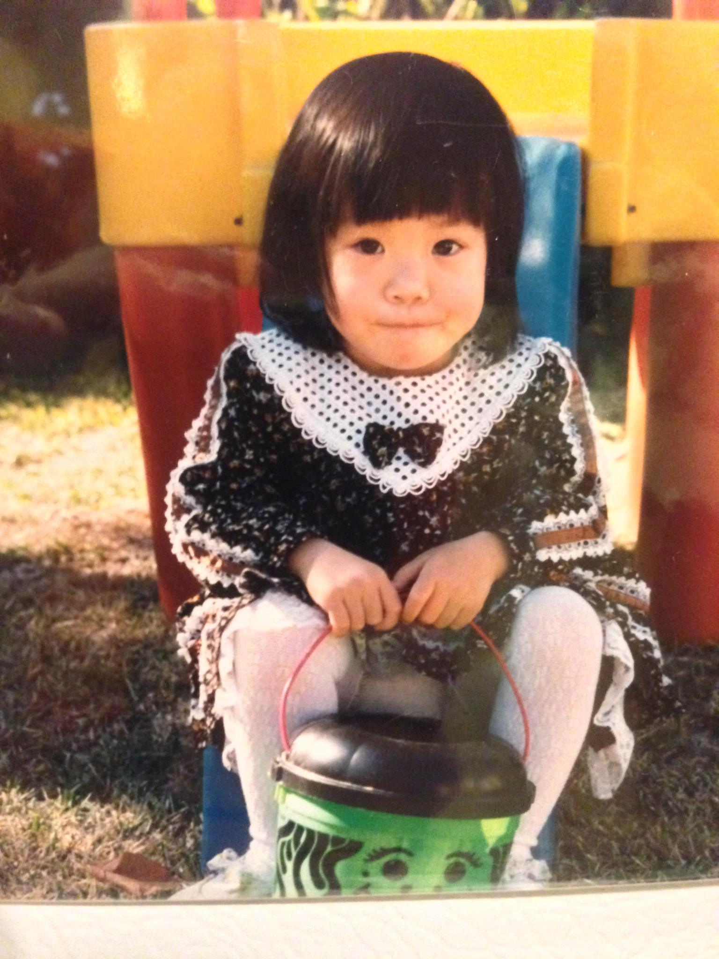
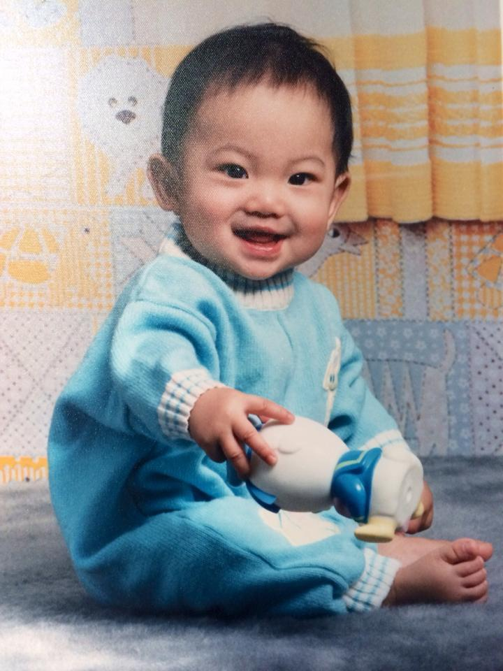
Guess the Excomm Baby!

Slide 36
Guess the Excomm Baby!
Melissa Ma
Sean Tran

Slide 37
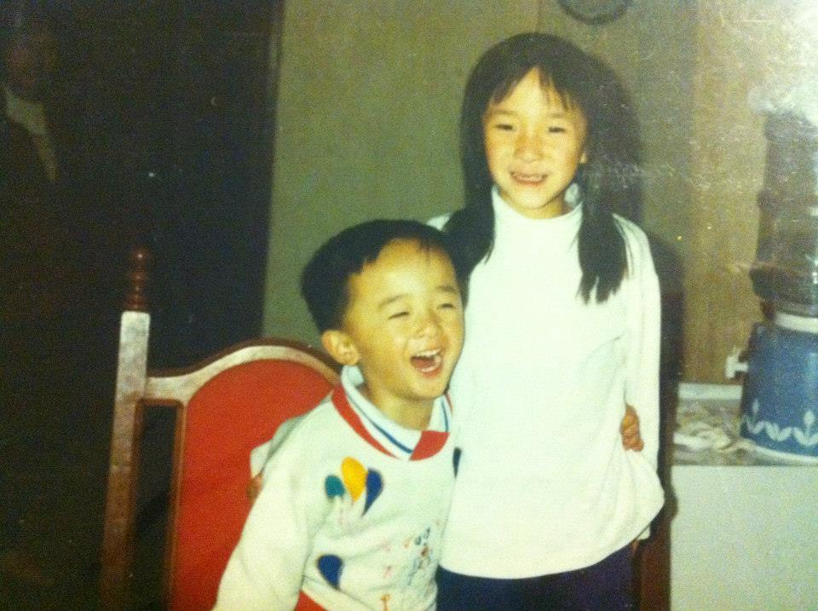
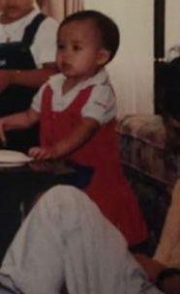
Guess the Excomm Baby!

Slide 38
Guess the Excomm Baby!
Dianne Pham
Joseph Chan

Slide 39
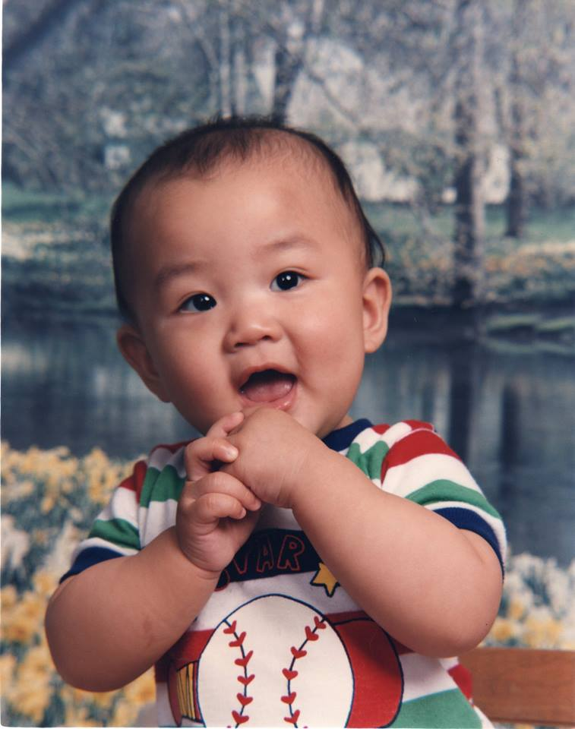
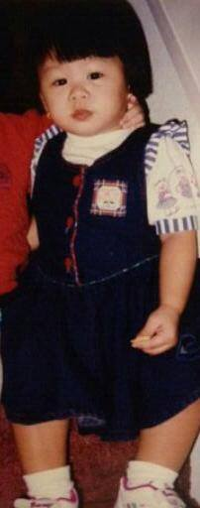
Guess the Excomm Baby!

Slide 40
Guess the Excomm Baby!
William Nguyen
Jessica Suhardjo

Slide 41
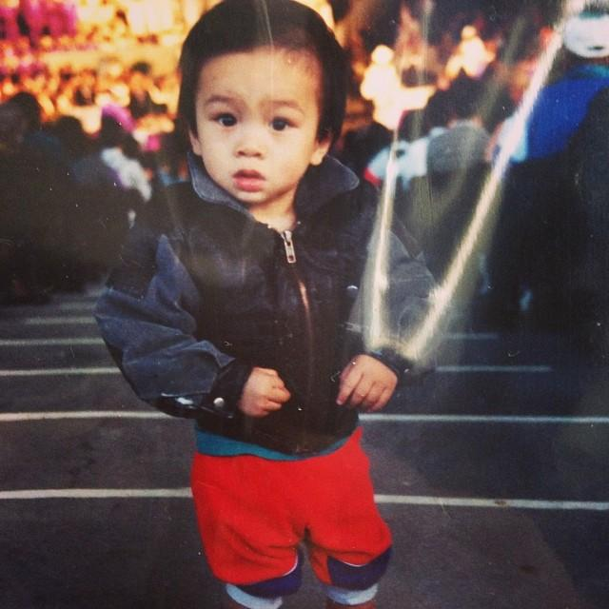
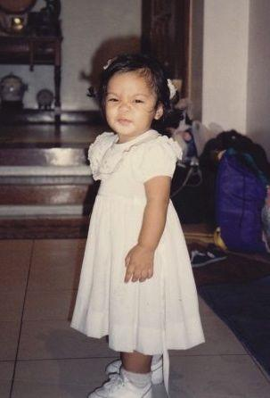
Guess the Excomm Baby!

Slide 42
Guess the Excomm Baby!
Tin Tran
Catherine Teotico

Slide 43
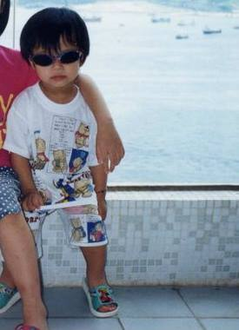
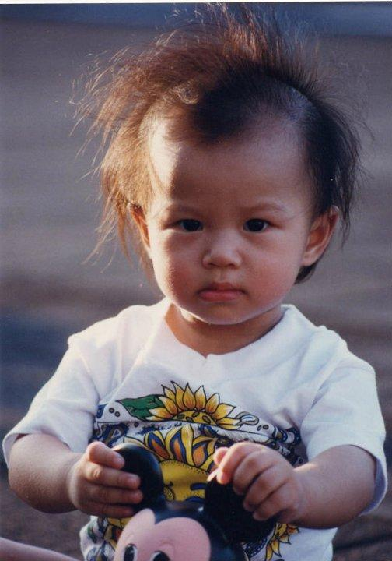
Guess the Excomm Baby!

Slide 44
Guess the Excomm Baby!
Just kidding, this is also Nicola
Nicola Yip

Slide 45
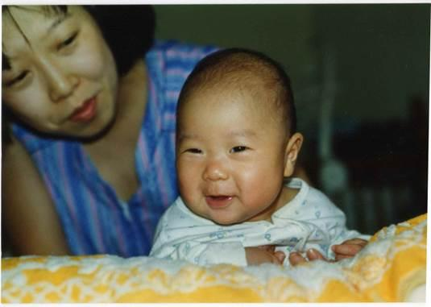
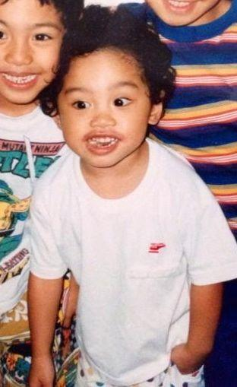
Guess the Excomm Baby!

Slide 46
Guess the Excomm Baby!
Olivia Pardo
Michael Hung

Slide 47
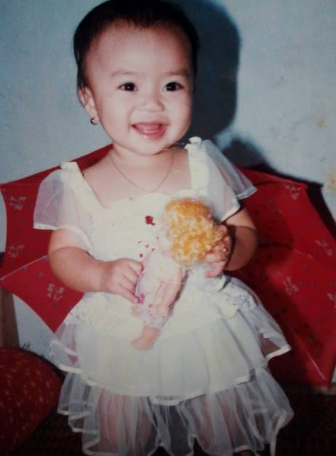
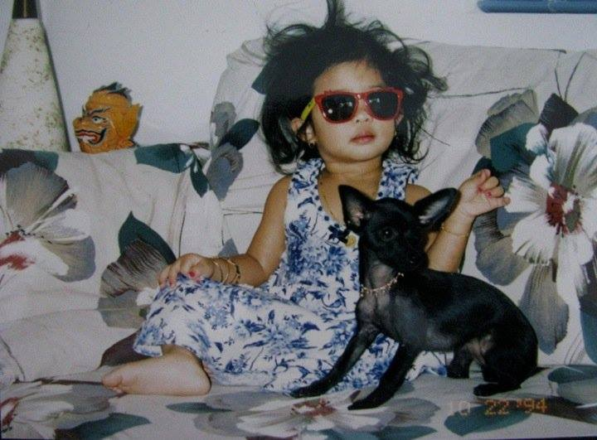
Guess the Excomm Baby!

Slide 48
Guess the Excomm Baby!
Jade Vo
Emily Neai-Proeung

Slide 49
Service VPs
William Nguyen & Jade Vo
service@apo-x.org

Slide 50
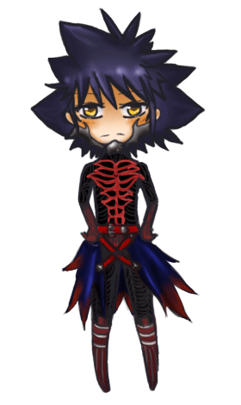
Registration
READ THE DESCRIPTIONS
Please do it
If you don’t you may NOT get credit for the event/a strike

Slide 51


New Policy! ~
If you sign up for this event, you MUST sign up 1 WEEK before the event occurs. This is usually because the event requires external registration.
If you decide to remove yourself within that week it will count as a flake = strike

Slide 52
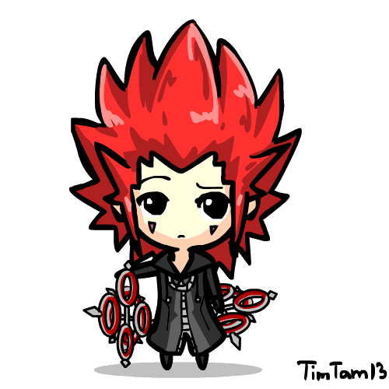
Updates on Benefit Concert
Alpha Phi Omega Presents: Illuminate Autism Benefit Concert
Venue: Moore 100
Date: May 24th (weekend of Jazz Reggae)
Artists:
Random Voices Confirmed with us
Talents within our CHAPTER? :D

Slide 53

Updates on Benefit Concert
Sound system
Waiting to talk to Event Manager
Ticketing
Presale or Donation at Door (required us to hired UCPD)
More info once we talk to our Event Manager!
Promotion
Publicity committee is looking for people to design the flyer for us

Slide 54
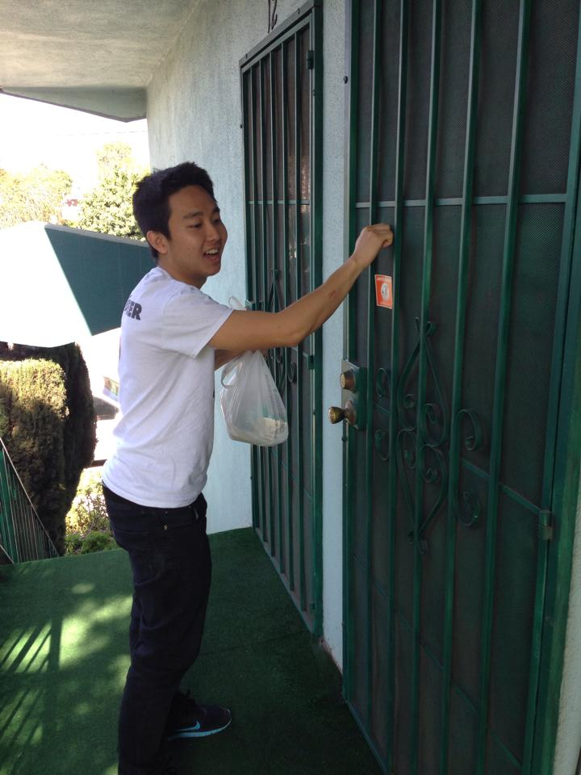
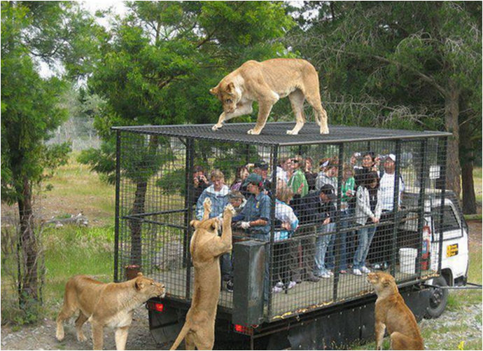
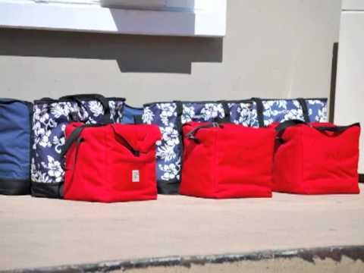
Education Committee Presents: Meals on Wheels
2 million volunteers deliver a nutritious meal, a warm smile and a safety check that helps keep 2.5 million seniors healthy and fed.
YAY!

Slide 55
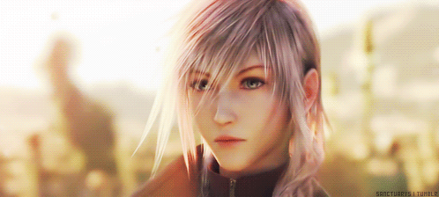
Meals on Wheels This Week!
Meals on Wheels needs people from any time from 9 - 3!
Help fold newsletters!
Get extra hours on top of the usual 2 - 3 hours!
Thanks Abelard!

Slide 56
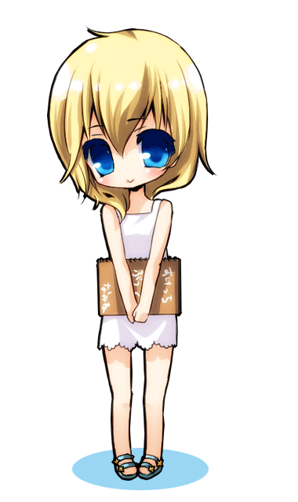
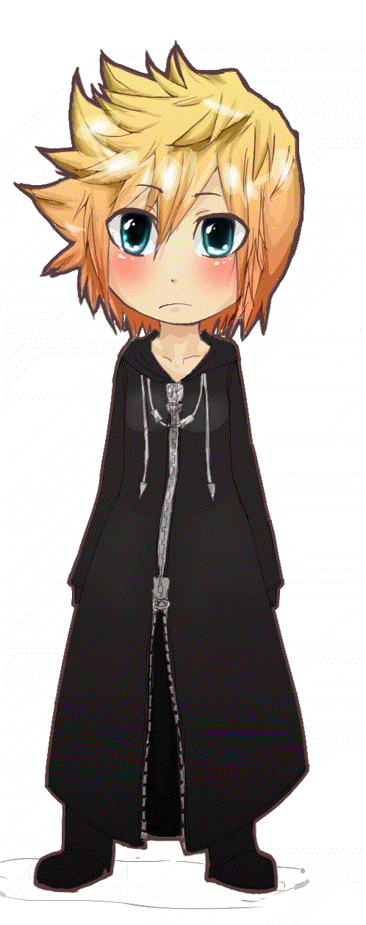

Service Brother of the Week!
Awarding Brothers for Going Above and Beyond!

Slide 57
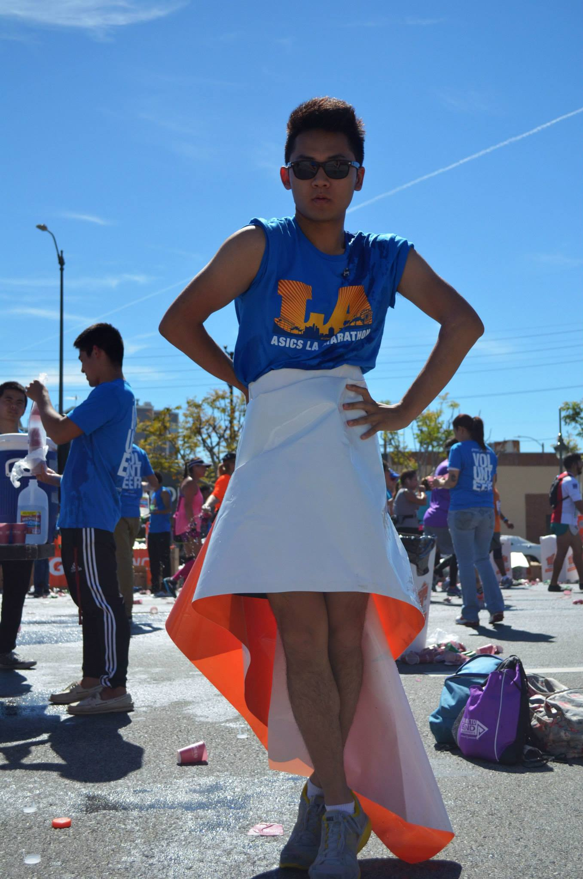


NATHAN CHEUNG
NATHAN CHEUNG!

Slide 58
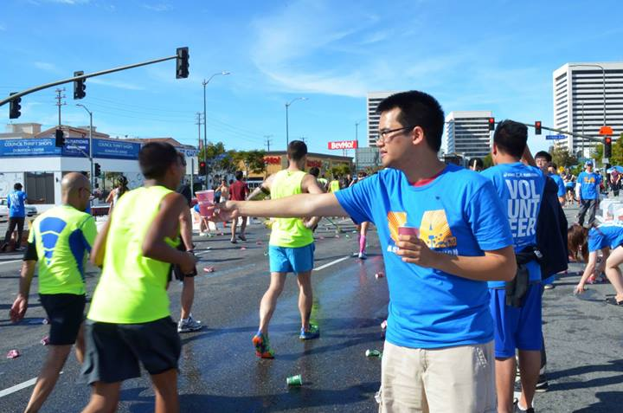

Peter Vo!

Slide 59
HELP REQUEST!
City of LA has an emergency winter shelter program that runs from December 1st through March 15th.
The whole program provides shelter for approximately 1500 people. As of the 15th of March,
All these 1500 individuals will have no access to shelter, food, hygiene items or clothing/blanket material.
Thanks Nathan for this info! :)
Any blankets, sleeping bags, socks, beanies, either new or lightly used but clean
Hygiene kits or individual items such as soap, small bottles of: moisturizer, shampoo, hand sanitizer, and also razors

Slide 60

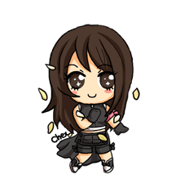
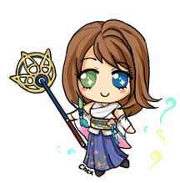
Collab with Circle K
Blanket Making + Clothing Drive +Fundraising? for Monday Night Mission
Suggestions? text me @ 626-242-3031

Slide 61
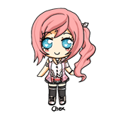
Garvey Youth Outreach!
Thank you guys again for sending so many volunteers out to us! They were all amazing to work with and I am very grateful for their help! I definitely want to make it out to a meeting one of these days, so I do hope I'll get to see them all again.
Thank you and have a wonderful weekend!
- Gladys

Slide 62
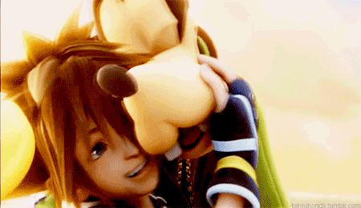
LA Marathon!
Hi All, Thank you all for volunteering at LA Marathon Mile 19 and making it a big success. We had worked as big family. Without all your support, help and confidence it would have not been possible. Students: You all were there before me and excited. I was little nervous when I came but seeing you confidence and support i was amazed. I really liked working with you guys.Thank you again and hope to see you next year again.
GO CHI CHAPTER!

Slide 63
Pledge Parents
Sean Tran & Annie Tran
pledgeparents@apo-x.org

Slide 64
Pledges
Quiz 2
-Pledge roster, toast song, mission and vision
-Music Video’s are coming soon!
-4 Part harmony is happening today!

Slide 65
Actives
-Interviews List is COMING
-Please please please come out to interview us
-Reminder that campout is happening
- Interviews/Issues
-Campout is happening peeps. remember to bring your stuff and sign up to drive

Slide 66
Flashback time baby

Slide 67
Fellowship VPs
Michael Hung & Dianne Pham
fellowship@apo-x.org

Slide 68

Fun Foursies
Groups made, will be sent out after meeting!
Take a picture and email it to us or post it to Facebook for credit.
Hopefully not this creepy

Slide 69
BUCKET LIST
DO IT.
Pics or it didn’t happen. (But actually.)

Slide 70
TALENT SHOW
Either May 2 or May 3 (not April 18)
Accepting acts/performances/bits/raps/jokes/stand-up/ speeches/dances from now until a week before
Let us know if you’re interested (or sign up on the binder).

Slide 71

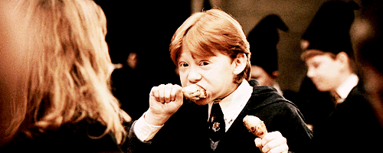
Banquet
May 30th

Slide 72

More Fellowships Later
Please study.

Slide 73
Historian
Tin Tran
historian@apo-x.org

Slide 74
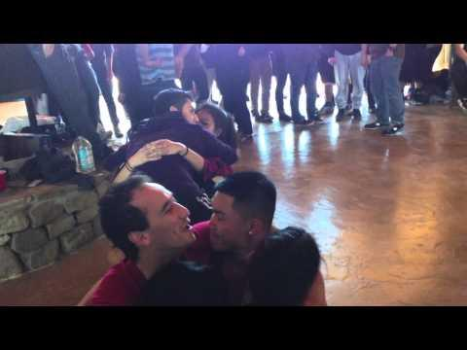
Webisode #1

Slide 75

Updates
Still working on online picture submission
Chi Chapter Flickr is in the works...

Slide 76
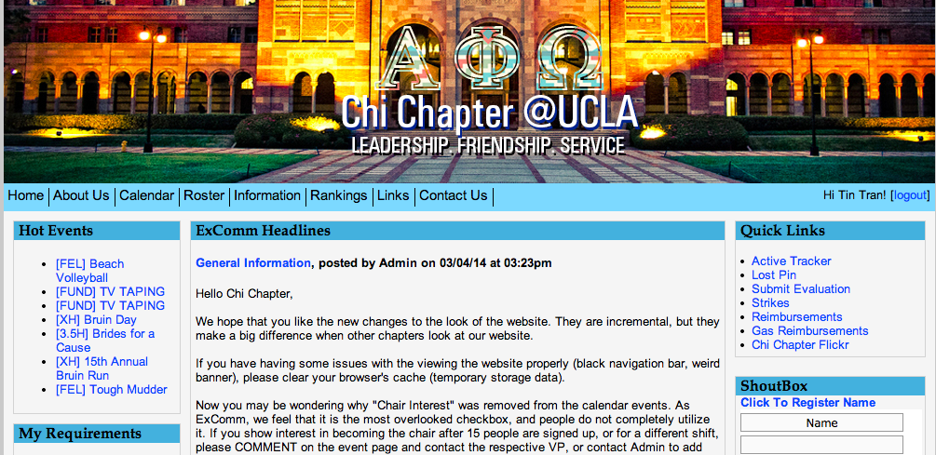
Chi Chapter Flickr

Slide 77
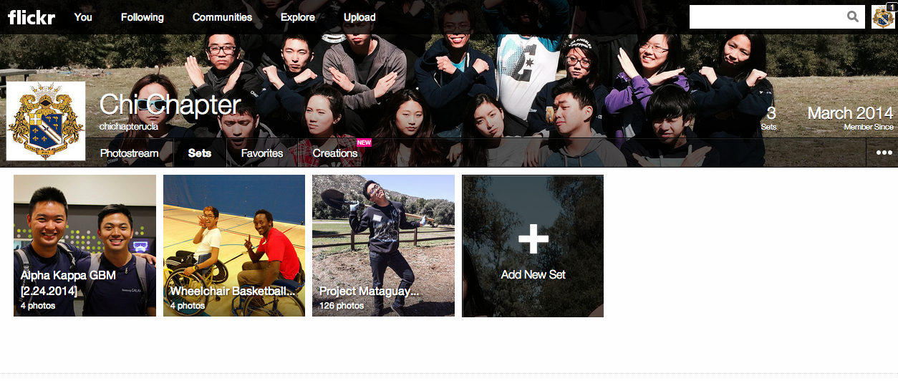
Chi Chapter Flickr

Slide 78
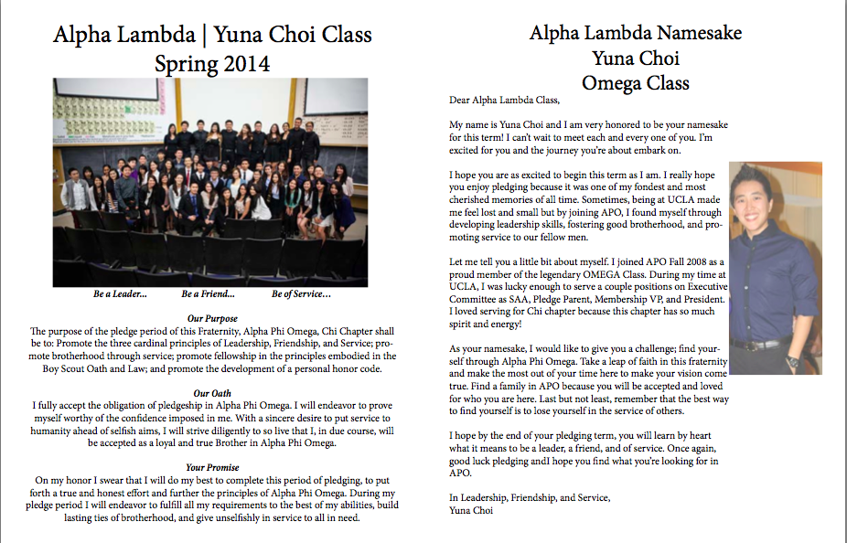
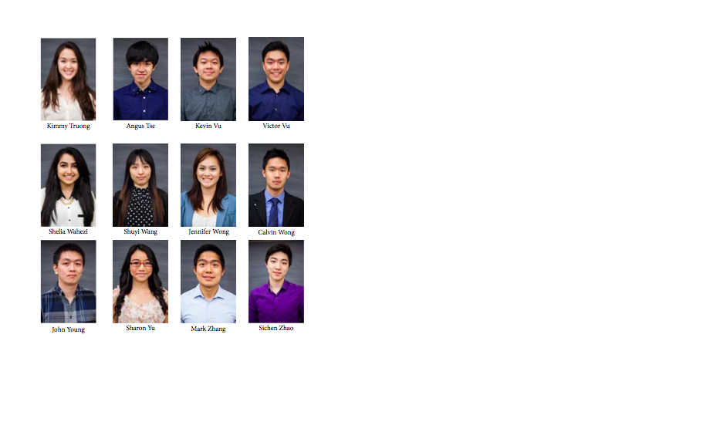
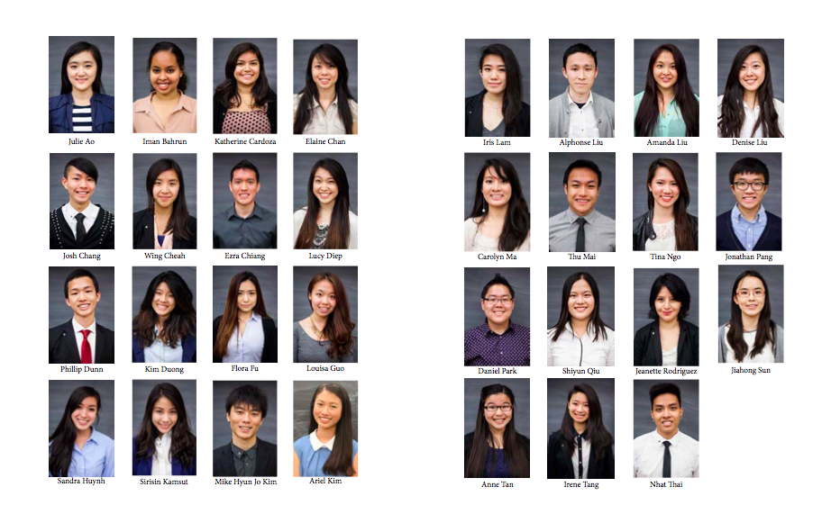
Progress on Termbook
Pledge Section is complete…that is all...

Slide 79

Progress on Termbook
GOOD STANDING ACTIVES
I NEED YO PICTURES

Slide 80

Chi Trivia
For pledges~
Who is your namesake and when did she/he pledge?

Slide 81
Chi Trivia
For pledges~
Who is your namesake and when did she/he pledge?
Yuna Choi
Omega Class

Slide 82
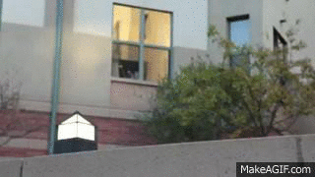
Chi Trivia
For actives~
More like APO Trivia...sorry LOL
Other than in the US, APO
has chapters in these three
countries

Slide 83
Chi Trivia
For actives~
Other than in the US, APO
has chapters in these three
countries : Australia, Canada,
and the Philippines

Slide 84
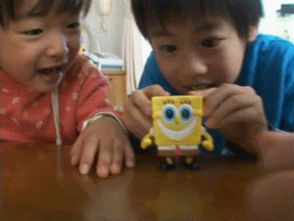
Brothers of the Week
There’s 3 this week~

Slide 85
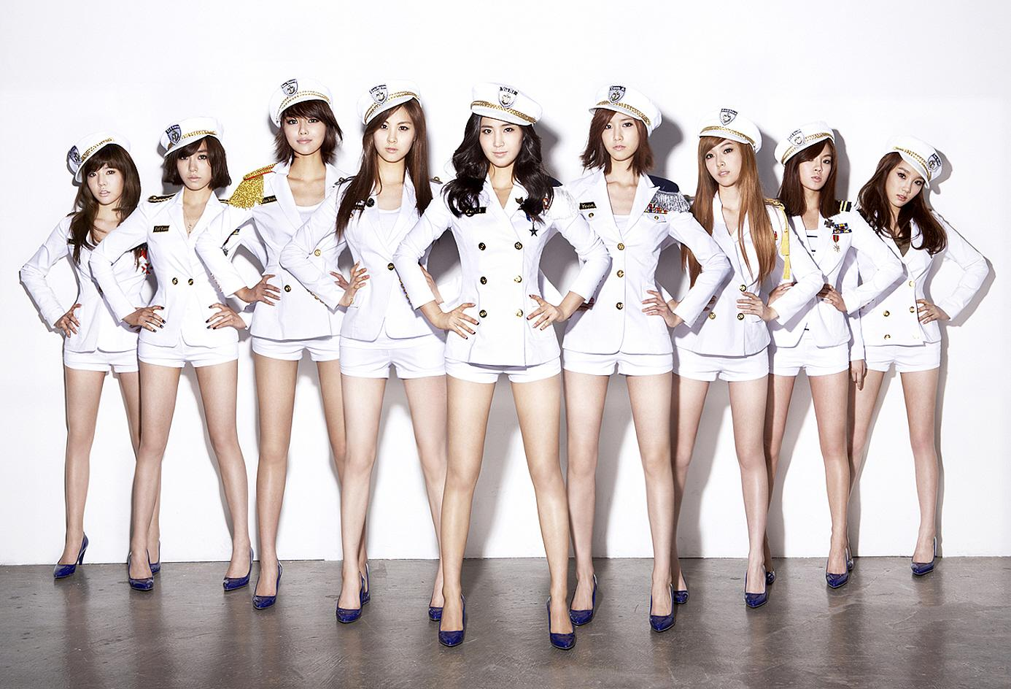
Brother of the Week #1
This brother is a big fan of Girls’ Generation.
gee
gee baby
gee baby
baby

Slide 86
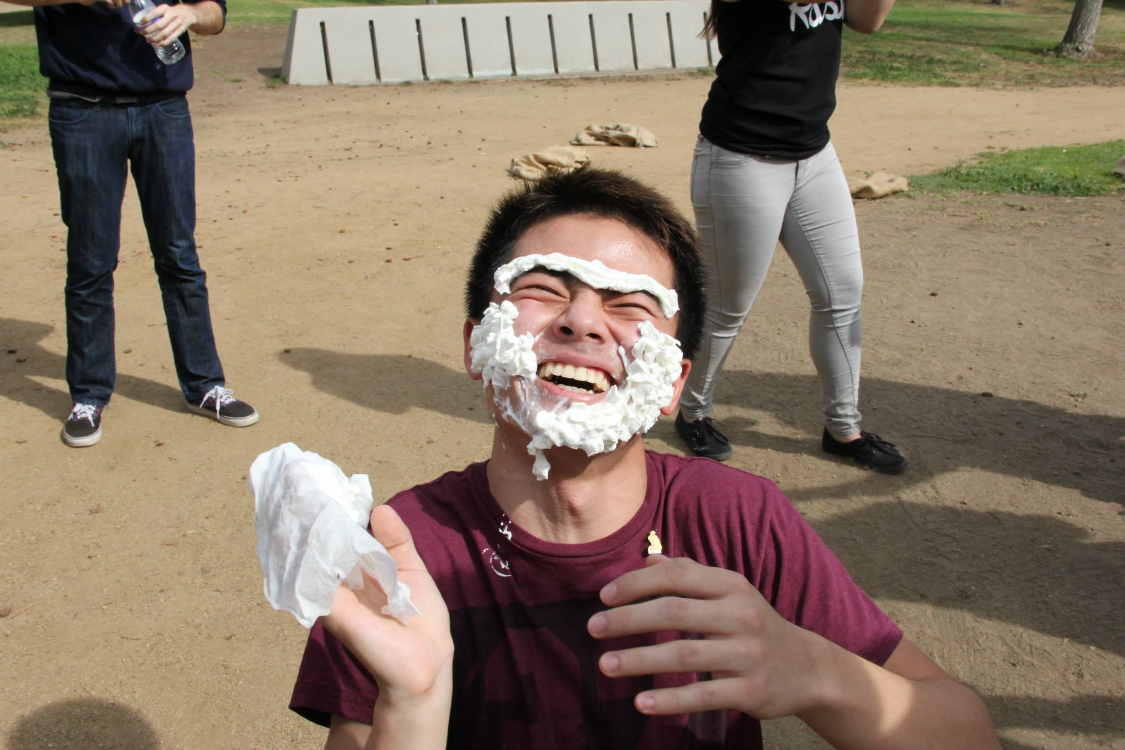
Brother of the Week #1
Rui Guo

Slide 87

Brother of the Week #2
This brother is probably the loudest person in Chi Chapter.

Slide 88
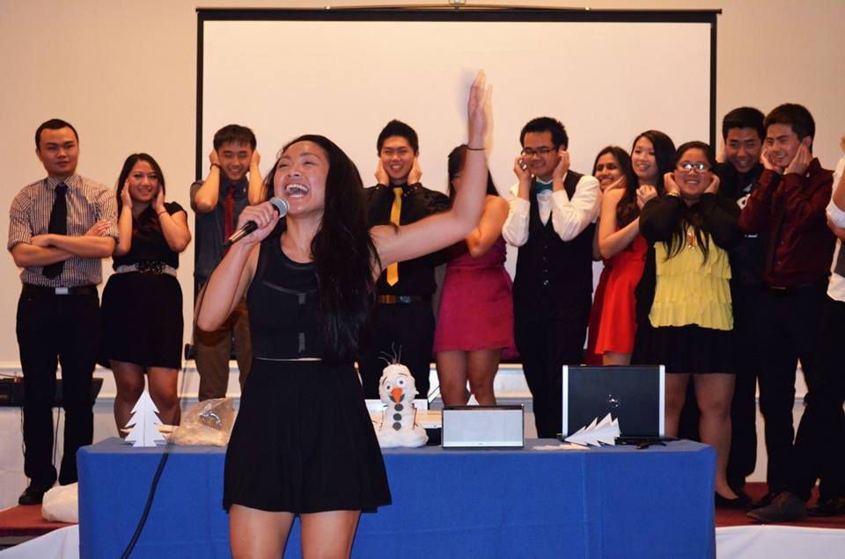
Brother of the Week #2
Olivia Pardo

Slide 89
Brothers of the Week #3
Okay, I lied. There are two more BOTWs. But it’s for the same reason!
These two brothers pledged Alpha Kappa term. One is a graduate student and the other likes to try different protein bars and write reviews on them.

Slide 90


Brothers of the Week #3
Peter Huang
&
Bowen Lu

Slide 91
End
Thanks for all the BOTW nominations.
Please keep doing so.
Suggestions?!
Email me!
apoxhistorian@gmail.com

Slide 92
Interchapter Chair
Olivia Pardo
interchapter@apo-x.org

Slide 93

Project Mataguay

Slide 94

Dance Comp
Dancers & Supporters
Sign up on the calendar AND google doc!

Slide 95

Section 1 Conference
Welcome ADT! ^__^

Slide 96
Chair of the
Advisory Committee
Kevin Lee
cac@apo-x.org

Slide 97
Update on Alumni Counselor Program
Last minute sign-ups?
Check for your e-mails for your
APO ALUMNI COUNSELOR :)

Slide 98
Career Preparation Workshops
Another Excel Workshop
Presentation Workshop

Slide 99

Alpha Lambda Namesake
Yuna Choi! :)

Slide 100
Finance VPs
Emily Neai-Proeung & Jonathan Liu
finance@apo-x.org

Slide 101

DUES $$$$$$$$
Pay dues by after meeting tonight!
otherwise you will go bad standing or be depledged!
Active dues: $75
Associate dues: $45
Actives on PP: $35
Pledges on PP: $20
Chase Quickpay to emilyneai@ucla.edu!

Slide 102


Ride situation (Mataguay)
If you were KChan’s car on the way up from Mataguay, come talk to us!
Please fill out gas reimbursement form
You will be partially reimbursed!

Slide 103


TV Tapings!
Great way to complete your fundraising requirements!
Sign up ASAP for the upcoming ones!
Next 2 TV tapings are close!
"WINKLERS"
Thursday 4/3
A new ABC comedy!
"Your Family Or Mine"
Thursday 4/10
A new comedy for TBS!

Slide 104
Chapter Business

Slide 105
Nominations
Taylor Briglio
Bowen Lu

Slide 106

Budget!
https://docs.google.com/spreadsheet/ccc?key=0AglafaSSFG48dEVlUURoLWNVaUdsTEVhcE5GblhzT0E&usp=drive_web#gid=0

Slide 107
Last Announcements

